Slide 1
Behavior Optimization for Swarm Navigation in Cluttered Environment
UAV

Slide 2
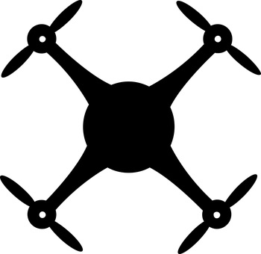
What?
Optimization of settling time in formation control of UAVs swarm navigation in the presence of obstacles
Settling time: Time taken by the agents to regain the formation
Formation is defined by the error in the velocity vector of agents and virtual leader

Slide 3

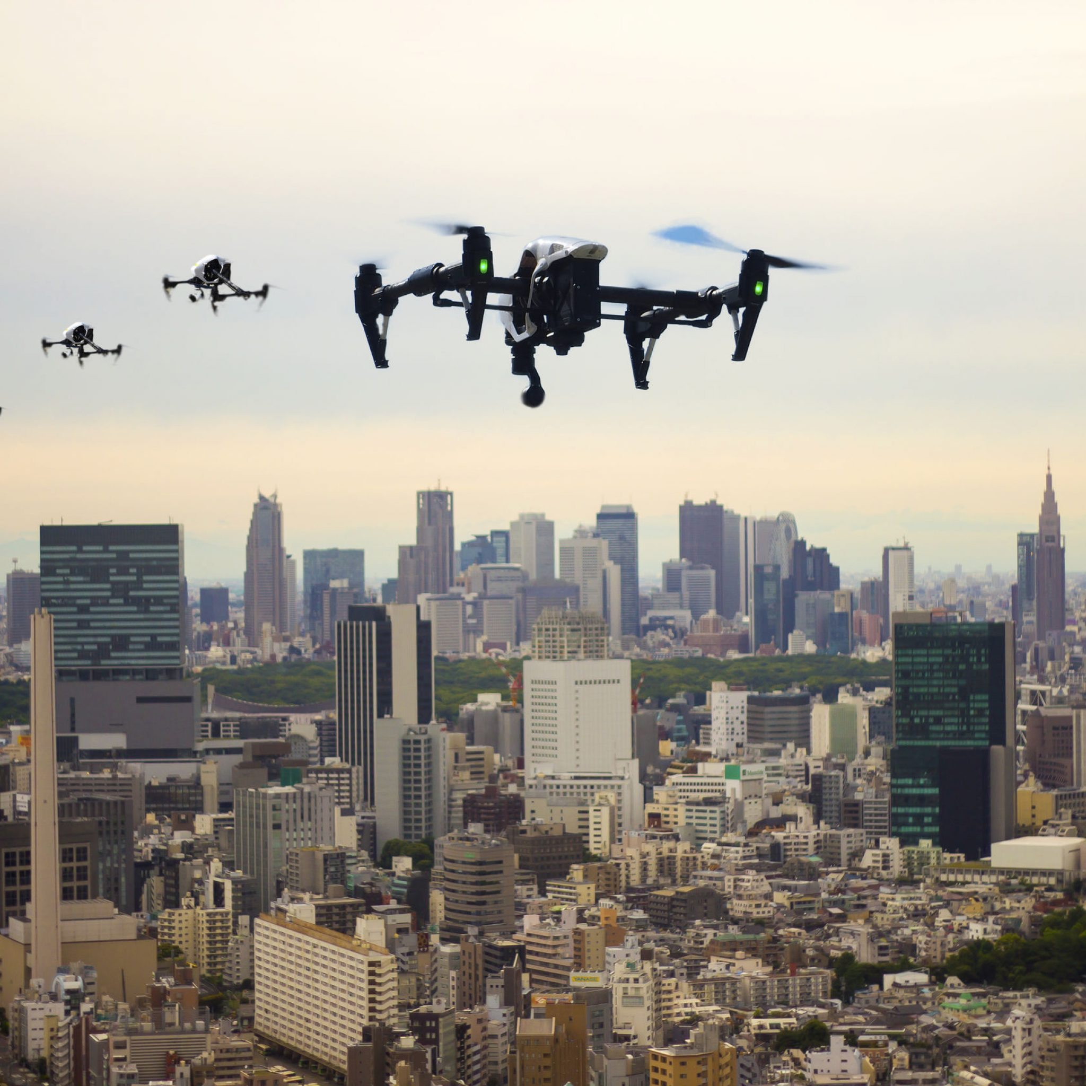
Why?
Many applications of UAV swarm navigation require maintaining a desired formation. One of these applications is geographical survey where any deviations from formation can create blind spots in the collective view of the swarm. Therefore it is essential that such deviations from formation keeping (such as obstacle avoidance) be kept brief.

Slide 4
How?
Formation control is achieved through lightweight methodology that uses conservative energy potentials in artificial relationships between group vehicles, a virtual leader, and their environment (obstacles)
6 dimensions – 5 force proportionality constants and 1 d_reaction(d_r) – “gains”
Penalized objective function – to accommodate constraints
K2*e_via
K1*(1/ia_d)*d1
K5*(d_r/d_obs^4)*d3
K3*(d0-vl_d)*d2
K4*e_vvl

Slide 5
Results/Findings
Appropriate reduction in simulation step size (“dt”) made the objective function (cost function) more continuous
Increasing the power of distance between agents and obstacle resulted in more desired behavior of the agents with respect to obstacle
Scaling the design variables reduced the number of function evaluations (“iterations”)
Different step size for different design variables –inappropriate change in particular design variables would highly worsen the cost and therefore those design variables would not show any change
1/d^2
1/d^4

Slide 6
Simulation Video
Simulation video

Slide 7
References
https://users.soe.ucsc.edu/~elkaim/Documents/IEEE_Aerospace_Swarm.pdf

